Slide 1





Festive Flourish :
Analysing AtliQ Mart’s Diwali 2023 & Sankrantii 2024 Promotions
Presented By
Tanisha Das
AKA Peter Pandey

Slide 2
PROBLEM
STATEMENT
DATA WALKTHROUGH
AGENDA
Understanding the KPI’s and Dashboard Overview
Ad-hoc requests and it’s solutions
Recommendations And Insights

Slide 3
PROBLEM STATEMENT
AtliQ Mart is a Retail giant with over 50 supermarkets in the Southern Region Of India
There was a promotion campaign during Diwali 2023 and Sankranti 2024 on their AtliQ branded products
With that the Sales Director, Bruce Haryali wants to understand which promotions were successful and which were not in order to make informed decisions for future promotional periods
The Analytics Manager, Tony delegates this analysis task to Peter Pandey, a curious data analyst at AtliQ Mart

Slide 4
The data model consists of 4 main tables:
1. dim_products
2. dim_stores
3. dim_campaigns
4. fact_events
DATA WALKTHROUGH
dim_products - This table consists of all the necessary information about the products. It includes product id, product name (specific description), category of product.
dim_stores - This table consists of the information of stores of Atliq located in different cities where Atliq has its supermarket.
dim_campaigns - This table gives us the idea about the promotion campaigns being run by Atliq in their supermarkets.
Fact_events - It gives information about unique sales event of Atliq supermarket.
Each record gives the info about product id , store id, base price, promo offer applied on it , as well as quantity sold before & after promotion.

Slide 5
Understanding the KPIs
KPI’S are key performance indicators. It is an important metric which helps us to track progress of our specific goal or objective.
Very important insights can be derived from this KPI’s to drive our business in more better way.
The important KPI’S which we have used to gain insights of the sales performance of Atliq by different promotion campaigns are as follows
Revenue After Promotion:- It can be defined as the revenue generated by Atliq sales after the application of promotion campaigns which are Diwali 2023 & Sankranti 2024.
Formula: Quantity sold after promotions * base price per unit
Total Revenue After Promotion
348M

Slide 6
Understanding the KPIs
Incremental Revenue % :- It is an important metric which indicates the impact of promotional campaigns in various cities with different categories of products.
Incremental Revenue (IR) = Revenue after promotion – Revenue before promotion
Formula:- ( IR / Revenue before Promotion) * 100
Incremental Revenue
(IR%)
147.23%
IR% of 147.23 means the revenue has increased 147.23% more compared to revenue before promotions.
Incremental Sold Unit % :- It can be defined as percentage of increase in sales of units of product due to promotions at Atliq stores.
Formula:- (Incremental quantity / quantity sold before promotion ) * 100
Incremental Sold Unit
(ISU%)
108.31%
ISU% of 108.31 means the percent hike in quantity of units sold after the promotions as compared to quantity sold before promotions.

Slide 7
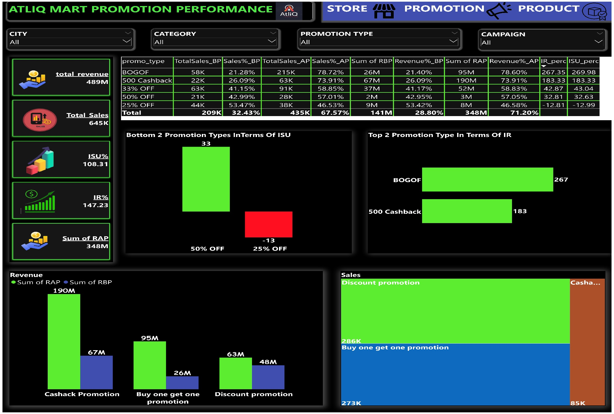
Dashboard Overview

Slide 8
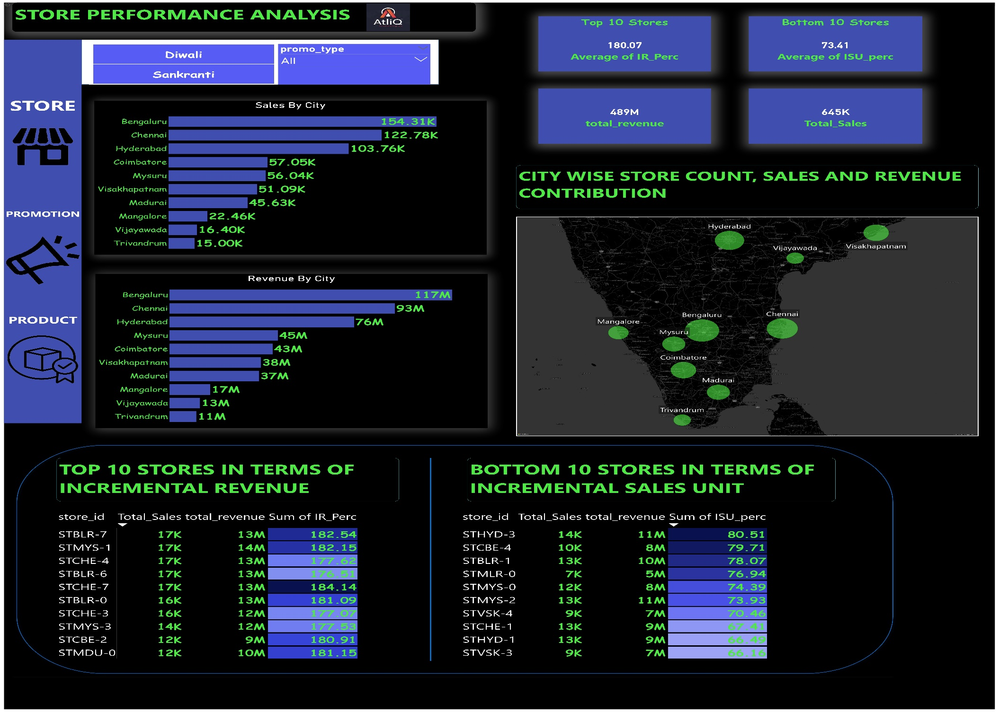
Dashboard Overview

Slide 9
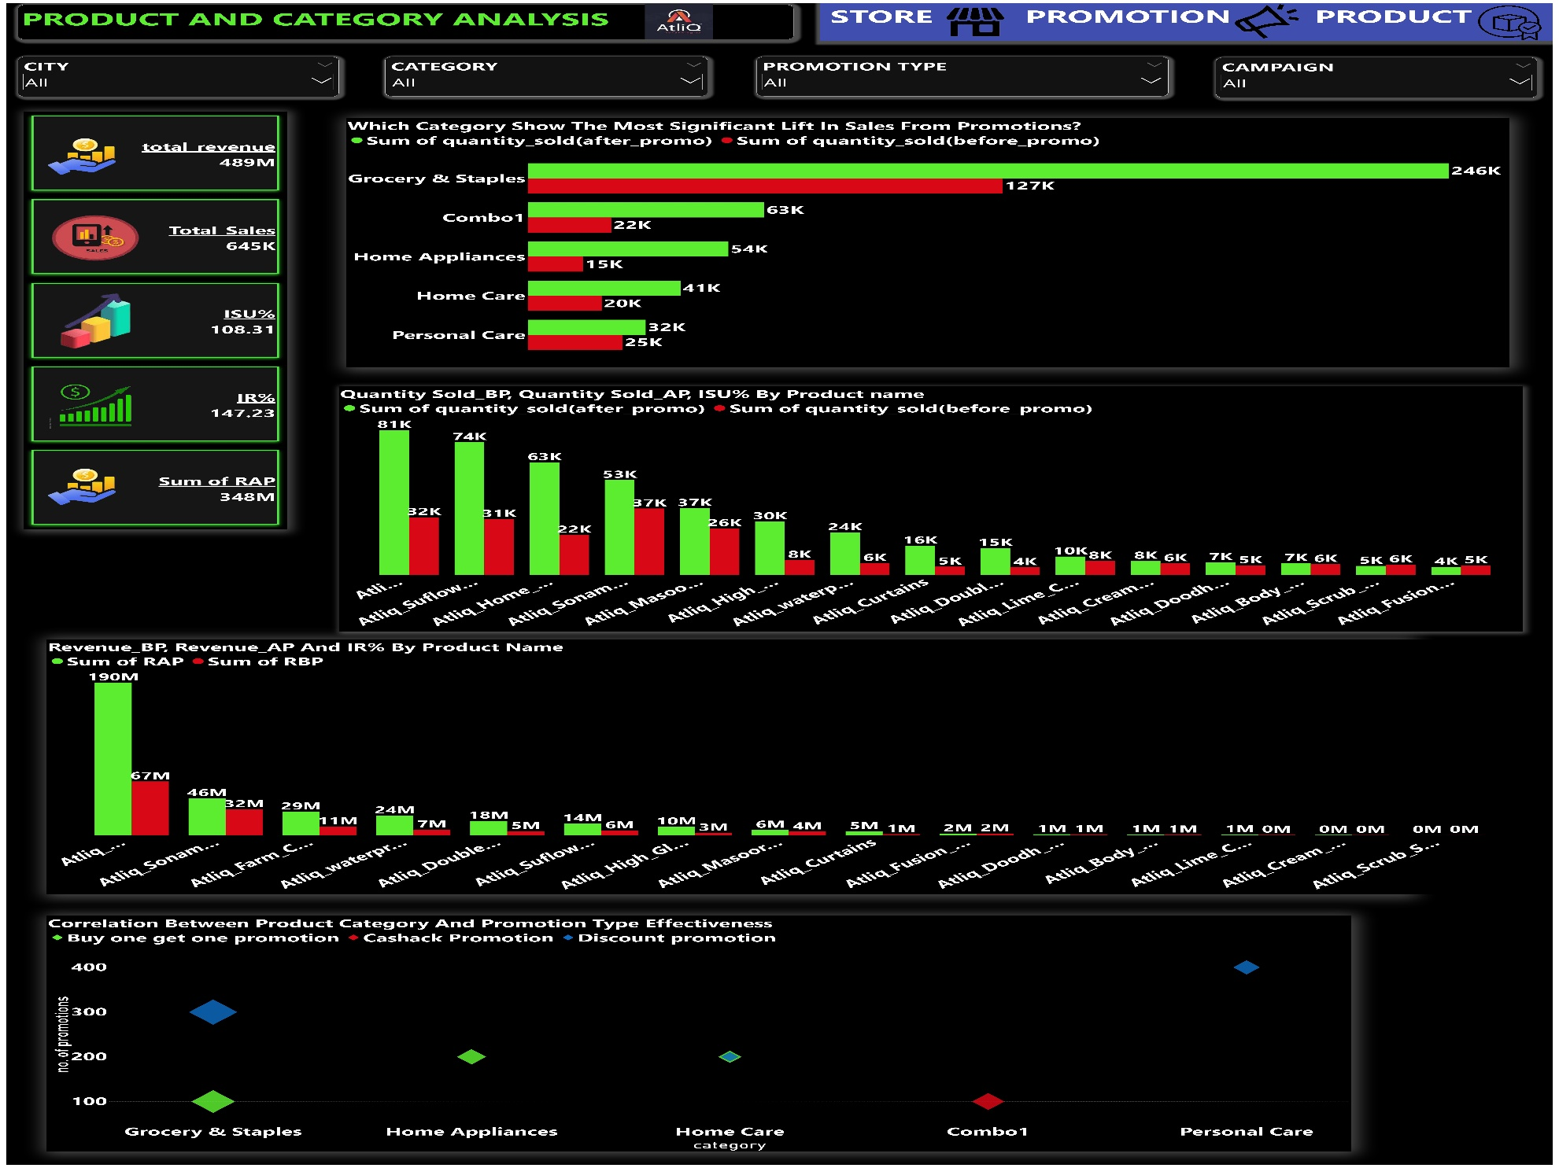
Dashboard Overview

Slide 10
Business Request 1
select distinct product_code,product_name from(Select f.product_code,p.product_namefrom fact_events f inner join dim_products p on f.product_code=p.product_codewhere f.base_price>500 and f.promo_type="BOGOF") tt;
Provide a list of products with a base price greater than 500 and that are featured in promo type of ‘BOGOF’ (buy one get one free).
product_code | product_name
P08 | Atliq_Double_Bedsheet_set
P14 | Atliq_waterproof_Immersion_Rod
Within AtliQ Mart, the Double Bed sheet Set and the Waterproof Immersion Rod are highlighted as high-value products. They are currently being offered at substantial discounts through 'BOGOF' (Buy One Get One Free) promotions.

Slide 11
Business Request 2
Select city, count(store_id) as store_countfrom dim_storesgroup by cityorder by store_count desc;
Generate a report that provides an overview of the number of stores in each city. The results will be sorted in descending order of store counts, allowing us to identify the cities with the highest store presence.
Bengaluru has the highest stores of Atliq which is 10 stores followed by Chennai & Hyderabad.

Slide 12
Business Request 3
select c.campaign_name,sum(base_price*quantity_sold_before_promo) as revenue_before_promo,sum(base_price*quantity_sold_after_promo) as revenue_after_promofrom fact_events f inner join dim_campaigns c on f.campaign_id=c.campaign_idgroup by c.campaign_name;
Generate a report that displays each campaign along with the total revenue generated before and after the campaign? The report includes three key fields: campaign_name, total_revenue(before_promotion), total_revenue(after_promotion).
Based on the visualization, it is evident that there has been a notable increase in revenue following the promotional campaigns conducted during both Diwali and Sankranti festivities.

Slide 13
Business Request 4
select category, round(((qap-qbp)/qbp)*100,2) isu_perc, rank() over(order by ((qap-qbp)/qbp)*100 desc) as rnk from(Select p.category,sum(quantity_sold_before_promo) as qbp, sum(quantity_sold_after_promo) as qapfrom fact_events f inner join dim_products p on f.product_code=p.product_codewhere f.campaign_id="CAMP_DIW_01"group by p.category ) as tt;
Produce a report that calculates the Incremental Sold Quantity (ISU%) for each category during the Diwali campaign. Additionally, provide rankings for the categories based on their ISU%. The report will include three key fields: category, ISU%, and rank order.
category | isu_perc | rnk
Home Appliances | 244.23 | 1
Combo1 | 202.36 | 2
Home Care | 79.63 | 3
Personal Care | 31.06 | 4
Grocery & Staples | 18.05 | 5

Slide 14
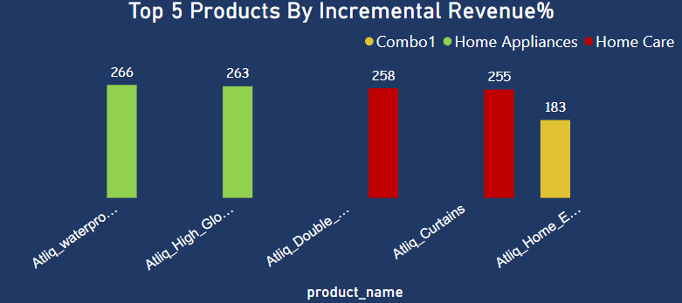
Business Request 5
select product_name,category, round(((rap-rbp)/rbp)*100,2) as IR_perc from(select p.product_name,p.category,sum(base_price*quantity_sold_before_promo) as rbp,sum(base_price*quantity_sold_after_promo) as rapfrom fact_events f inner join dim_products p on f.product_code=p.product_codegroup by product_name,category) tt order by IR_perc desclimit 5;
Create a report featuring the Top 5 products, ranked by Incremental Revenue Percentage (IR%), across all campaigns. The report will provide essential information including product name, category, and IR%.
This report helps us to identify the products which had maximum promotion impact on them. Home Appliances of AtliQ have huge revenue increment across both the campaigns

Slide 15
Bengaluru, Chennai, and Hyderabad are the top cities with the highest number of stores, collectively representing 50% of the total stores in the southern region of India.
Total sales and revenue in Bengaluru, Chennai, and Hyderabad collectively contribute to more than 58% of the total sales and revenue in the southern region of India.
Within the AtliQ Mart, the Double Bedsheet Set and Waterproof Immersion Rod are the high-value products having base price more than ₹ 1000/- offered at significant discounts through 'BOGOF' promotions.
The Diwali and Sankranti campaigns resulted in substantial revenue increases, with revenue surging by 151% and 141% respectively.
Home Appliances and Combo1 categories experienced the highest ISU% i.e. 244% & 202% respectively, indicating a significant increase in sales during the Diwali campaign.
The Waterproof Immersion Rod, High Glo LED Bulb, Double Bedsheet set, Curtains and Home Essential 8 Product Combo are the top 5 products in the AtliQ Mart, generated substantial incremental revenue (IR%) percentages across all campaigns.
INSIGHTS

Slide 16
Focus on optimizing retail operations in Bengaluru, Chennai and Hyderabad cities to maximize profitability, while also exploring expansion opportunities in other promising cities.
Given the significant contribution from top 3 cities i.e. in Bengaluru, Chennai & Hyderabad, focus on customer engagement, retention strategies, and operational efficiency to further boost sales and revenue.
Consider leveraging similar promotions for other high-value products to stimulate sales and attract customers.
Continue investing in impactful promotional campaigns during festive seasons and analyze campaign strategies to replicate success in future campaigns.
Allocate resources and marketing efforts towards categories with higher ISU% to capitalize on seasonal demand and maximize incremental sales.
Prioritize the top-performing products in promotional activities and ensure sufficient stock availability to meet increased demand.
RECOMMENDATIONS

Slide 17
THANK YOU

